Slide 1
Project Hawkeye 1
Critical Design Review (CDR)
29th August 2025

Slide 2
Agenda
Design and Development Approach
System Design
System Architecture Overview
Security
Data Backup
Data Archival and Housekeeping
Export Data to Link Analysis software
Software Features
Workflow
Features
Data Migration Tool
DBMS UI Demo

Slide 3

Design and Development Approach
Agile methodology is adopted as the design and development approach, which provides a flexible and adaptive approach.
Two software verification and iteration are scheduled:
Oct 2025;
Jan 2026;
Notes:
By end Jan 2026, we hope to capture major and essential requirements.
After Jan 2026, requirements changes should be minor.

Slide 4
System Design

Slide 5
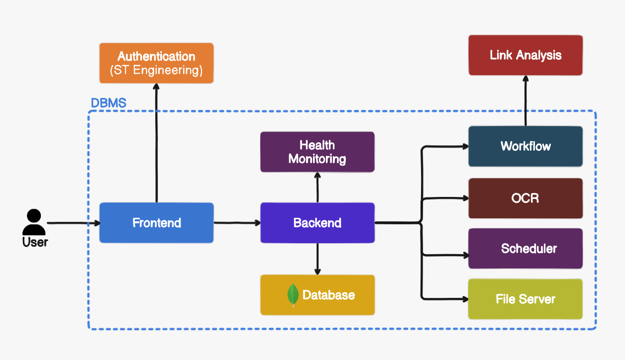
System Architecture Overview
Why Mongo?
NoSQL database
Flexible data model – changes without downtime
Supports automatic failover
Scalable
Notes:
The objectives of the system design is to build a scalable, reliable and efficient software system.
Airflow is a robust platform for orchestrating workflow and manging microservices.
The following design concept are used:
Client-Server architecture;
Load Balancer – distributes incoming traffic across multiple servers to prevent any single server from being overwhelm
Caching – stores frequently accessed data in memory to reduce retrieval time and database load
Database sharding – sharding splits a large database into smaller, manageable pieces (shards) stored on different servers
Microservices architecture – breaks down an application into smaller, independent services
Rate Limiting – restricts the number of requests a user can make in a given time to protect the system from overloading;

Slide 6
Security
Key Areas | Design Approach
Infrastructure & Servers | All servers and infrastructure shall be hardened (AFE); All servers shall installed with anti-virus/malware software to scan for vulnerabilities regularly;
Data Protection | Implement TLS (Cryptographic protocol) to provide data encryption for communication over the network;
Authentication & Authorisation | Use Keycloak for authentication and role-based access control
Security Testing | Use SonarQube to run SAST (Static Analysis) regularly, which can detect security vulnerabilities
Security Monitoring | Implement logging and auditing to track user access and changes to data; Monitor logs, detect anomaly behaviour
Notes:
SAST – Static Application Security Testing…
TLS/SSL
Anomaly like unexpected patterns like traffic surges, drastic changes in application performance or suspicious IP connections… (ELK)

Slide 7




Data Backup
Main Database
Backup
Service
Backup Storage
Full database and files backup will be performed at 3am daily*.
(Backup schedule is configurable)
File Storage
* - Default setting & value is configurable
Notes:
Still can operate … during put *
Tessaract… we have try 3 – 4 tools and we narrow down to this refined pdf text extractor

Slide 8

Data Archival & Housekeeping
Default data retention period is 3 years. This is configurable.
Data Archival
Move data that is > 3 years old*
Data Archival is scheduled to be perform annually.
(Archival schedule is configurable)
Main Database
Archived Database
Housekeeping
Delete data from archived database and its associated file that is > 6 years old*
Data Housekeeping is scheduled to perform after Data Archival.
Archived Database
File Storage
* - Default setting & value is configurable

Slide 9
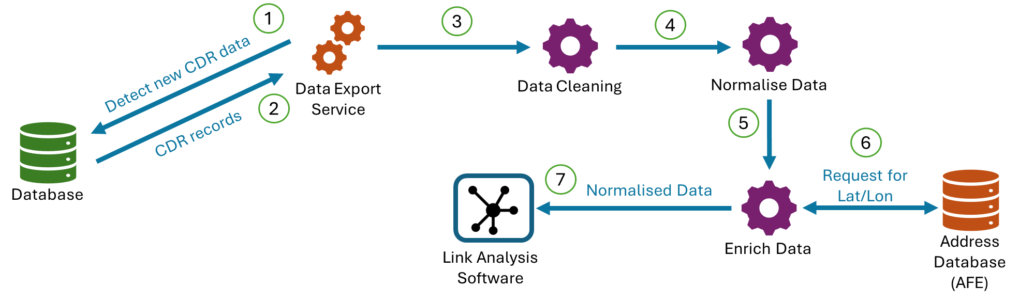
Export data to Link Analysis
Data Export Service will continuously detect for new CDR data

Slide 10
Software Features

Slide 11
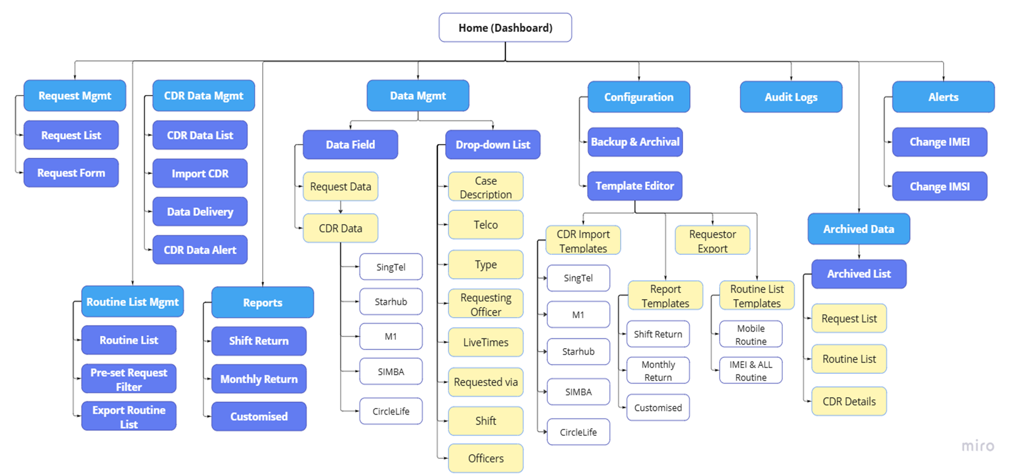
DBMS Features

Slide 12
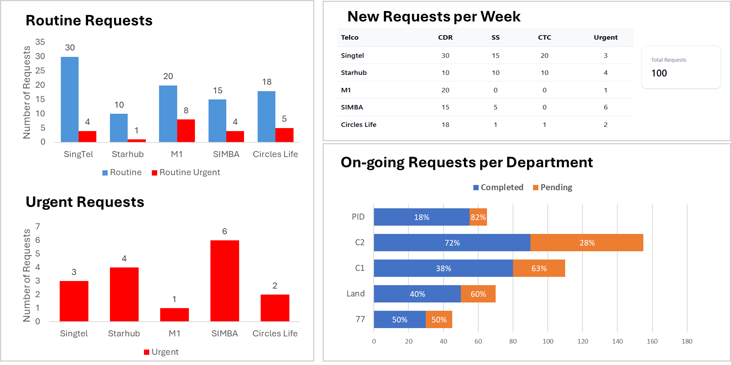
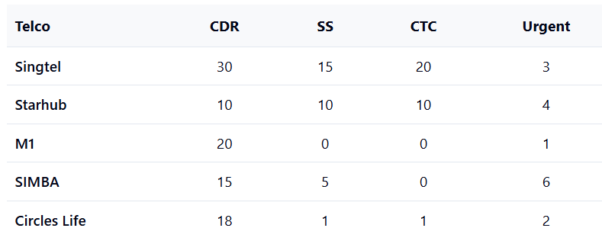
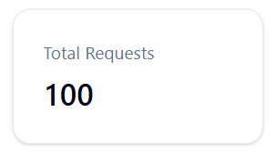
Dashboard
Shows the number of new requests for each telco per week.
CDR & SS value includes urgent requests
Total urgent requests
(CDR + SS)
Shows total number of CDR requests for each telco per week.
Shows request completion progress for each dept
Completed(%) =
Total number of requests fulfilled / Total requests from dept
Shows total number of Urgent requests for each telco on weekly basis, including both CDR and SS requests.
Notes:
Routine and Urgent requests per week (including in-progress and new)

Slide 13



Dashboard Features
…
…
Telco view
Requestor view
Export Chart
Able to switch view between
Telco view - # of Requests vs Telcos
Requestor view - # of Requests vs Requestors
Enlarge Chart View
…
…
Example, # of Requests vs Requestors
A D E Air Sea

Slide 14
Type of Requests
CDR
Routine CDR Request
Urgent CDR Request
Routine-Urgent CDR Request
SS
Routine SS Request
Urgent SS Request
CTC
CTC Request
Request Created via
Manual key in
Import form with structured data (Auto-populate)
Using OCR for PDF;
Word/Excel;
Table in Email content/body (.MSG/PDF format)
Import form with unstructured data (Email)
View content from Email;
Select and copy Email content;
Paste the copied content to the request form
Duplicate from existing requests

Slide 15
Request Extension
Types of extension:
Extend Request Period (applies to request start and end date)
Change Service Provider
Change Project Name
Request can be extend via
Manual key in
Import form with structured data
Using OCR for PDF;
Word/Excel;
Table in Email content/body
Import form with unstructured data (Email)
View content from Email;
Select and copy Email content;
Paste the copied content to the request form

Slide 16
Request Form (OCR)
Improve OCR accuracy:
Tested multiple CDR sample forms with the refined pdf text extractor, which yields high accuracy;
When the new Request Form Design is approved,
Get the new Request Form template and samples;
Consult ST/User on creating and populating the form with synthetic data, which should be as close to the actual operational data as possible;
Verify the performance and observe its accuracy through more tests.
Notes:
Well-known OCR tools…tested a few more tools … then outsystems… with restriction and limitation
On high-code with more options to look at…

Slide 17
Uploading encrypted files
Provide the capability of decrypting AES-Encrypted file.
Upon
Uploading request forms or email;
Uploading CDR zip folders from Telcos;
Retry attempts to decrypt file is 3

Slide 18
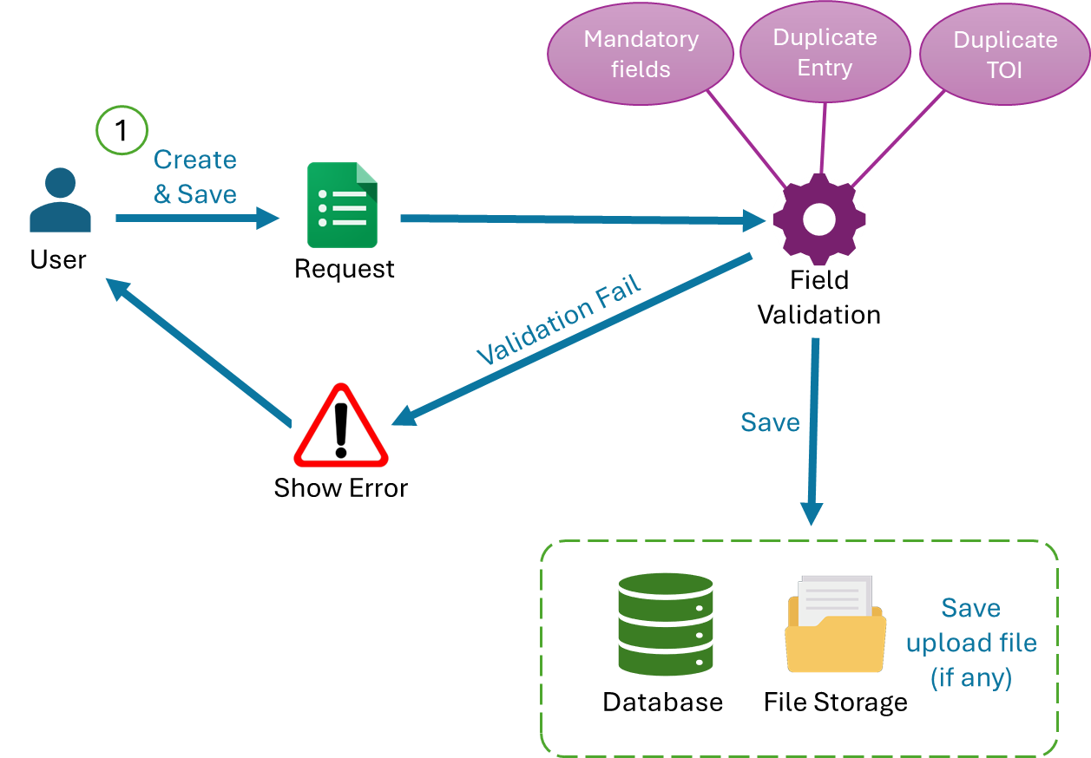
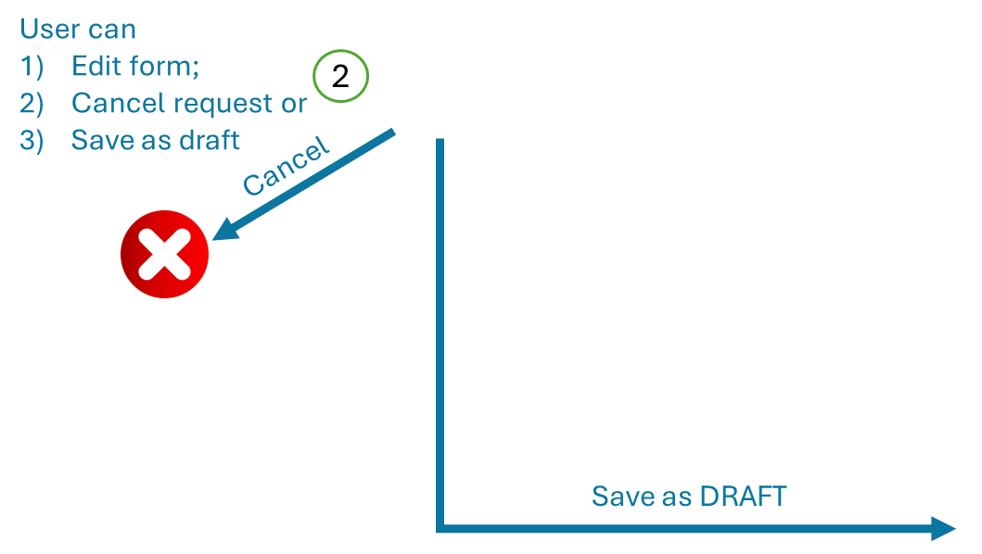

Request Creation (CDR/SS/CTC)

Slide 19
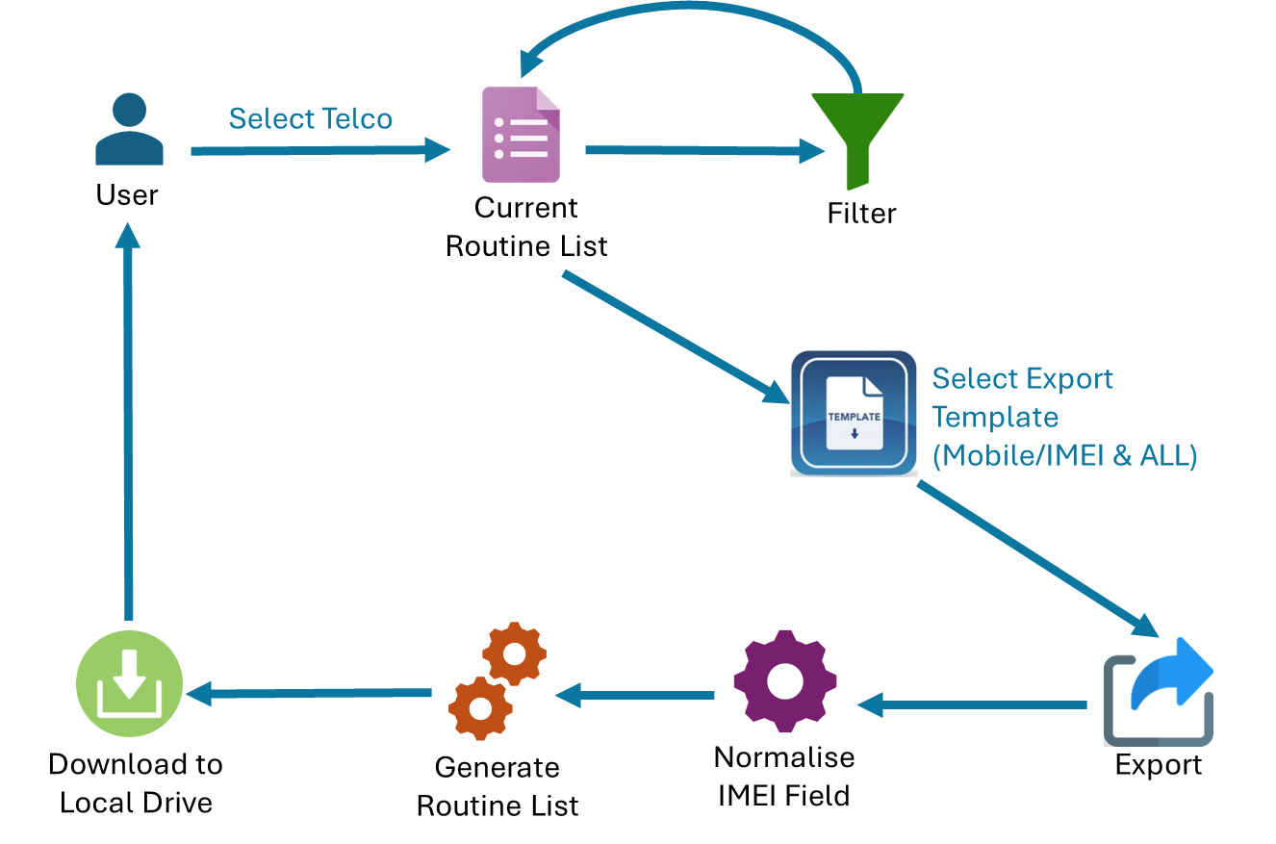
Request Data from Telco (CDR)
IMEI Normalisation
Take the 1st 14 digits from IMEI field and append “0” at the last digit.
Notes:
IMEI … check is it imei or imsi…

Slide 20
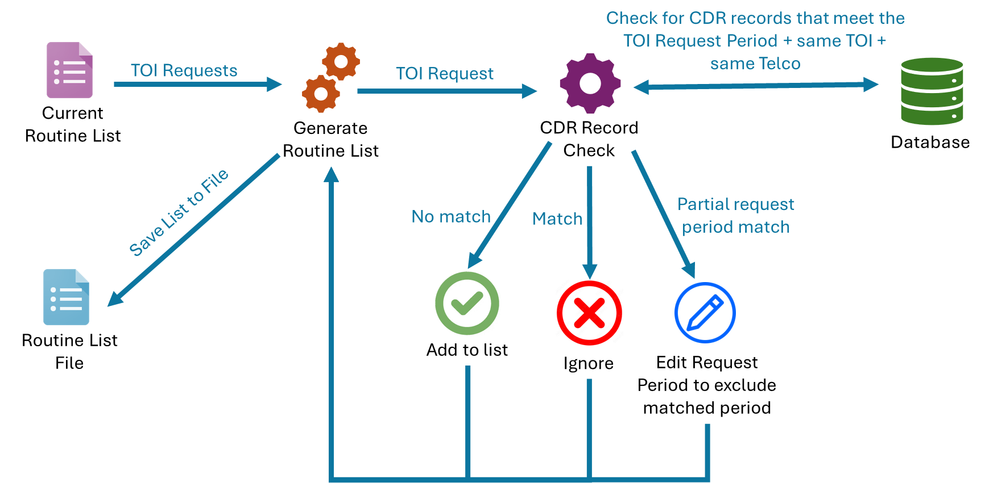
Generate Routine List

Slide 21
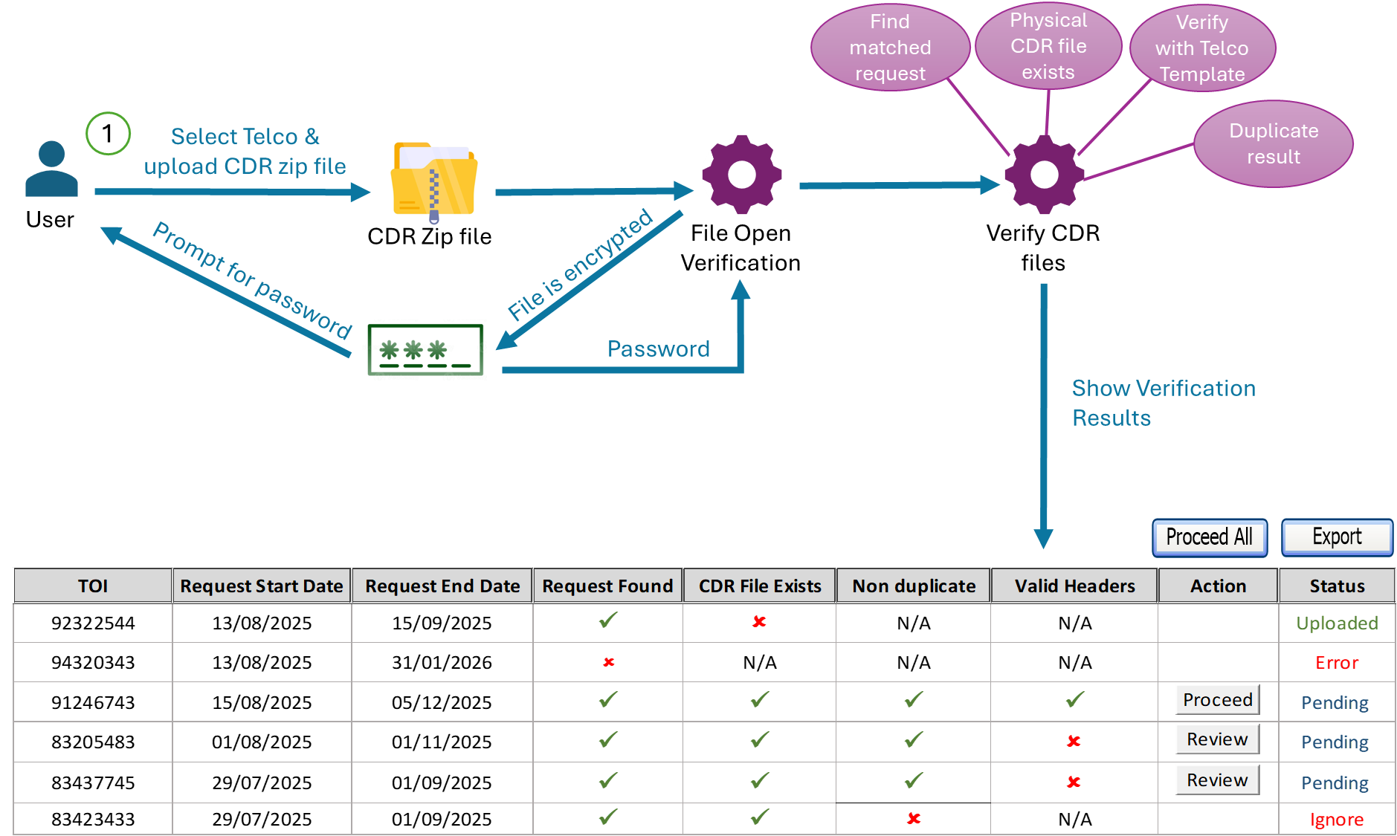
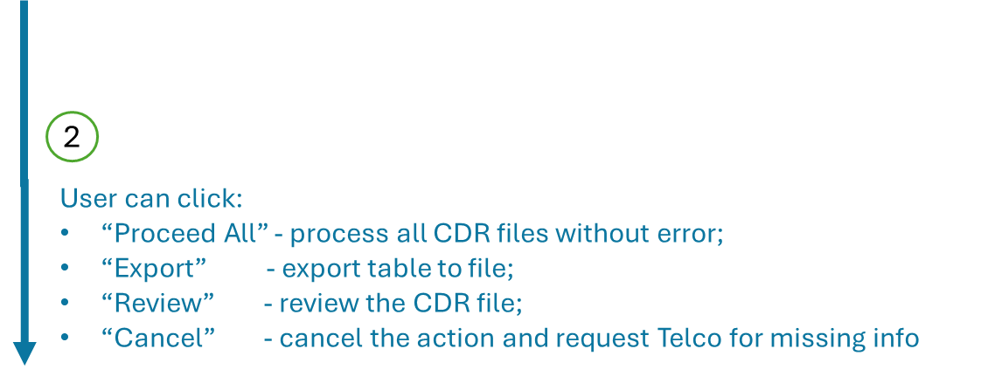
Import CDR from Telco (Batch Upload)

Slide 22



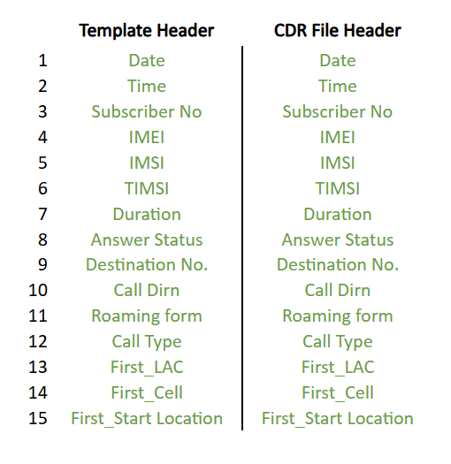
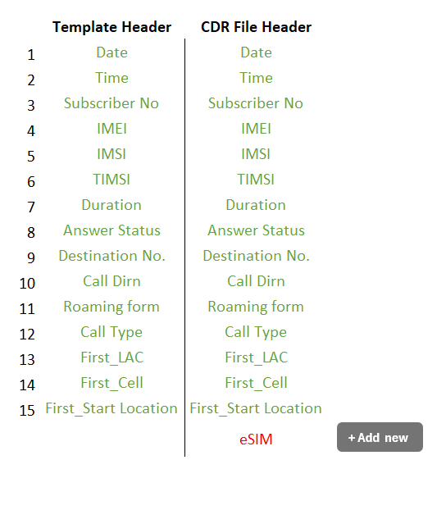
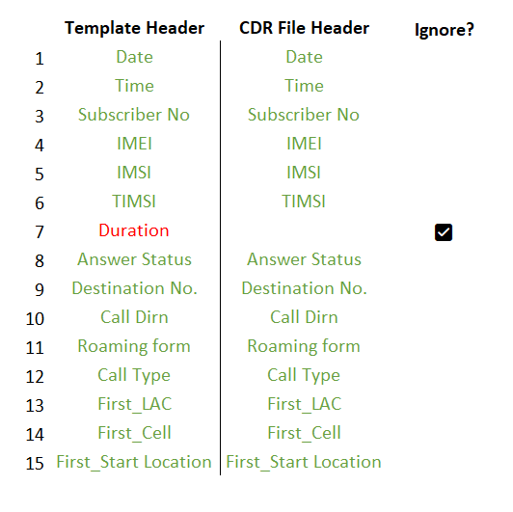
Verify CDR file with Telco Template (Review)
All column headers from CDR data file matches with template
Extra column header detected from CDR data file
Missing column header detected from CDR data file
Select checkbox to proceed with data processing with missing column
Redirected to Template Editor on Designer Role

Slide 23

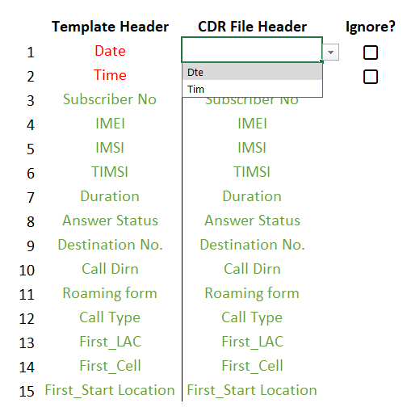
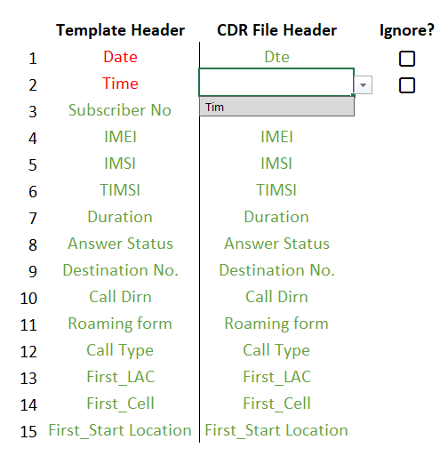
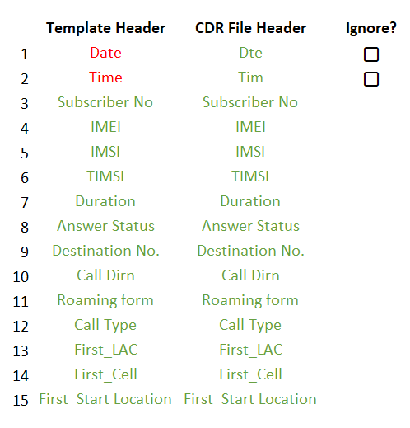
Verify CDR file with Telco Template (Review)
Spelling error on headers in CDR. System unable to detect and match with template.
Users must manually match the CDR columns to the template headers.
Any misspelled column headers that were not automatically detected should be selected by the user from a dropdown list.

Slide 24
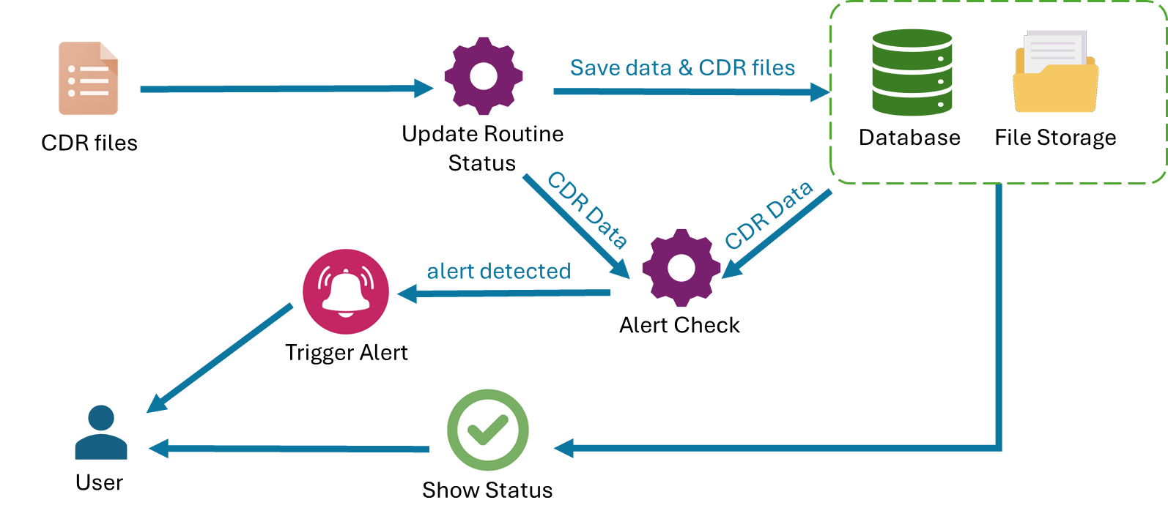
Import CDR data from Telco (Batch Upload - Save)
Update “Period Collected Till”, “CDR-Action”, “1st Delivery Date”, etc

Slide 25
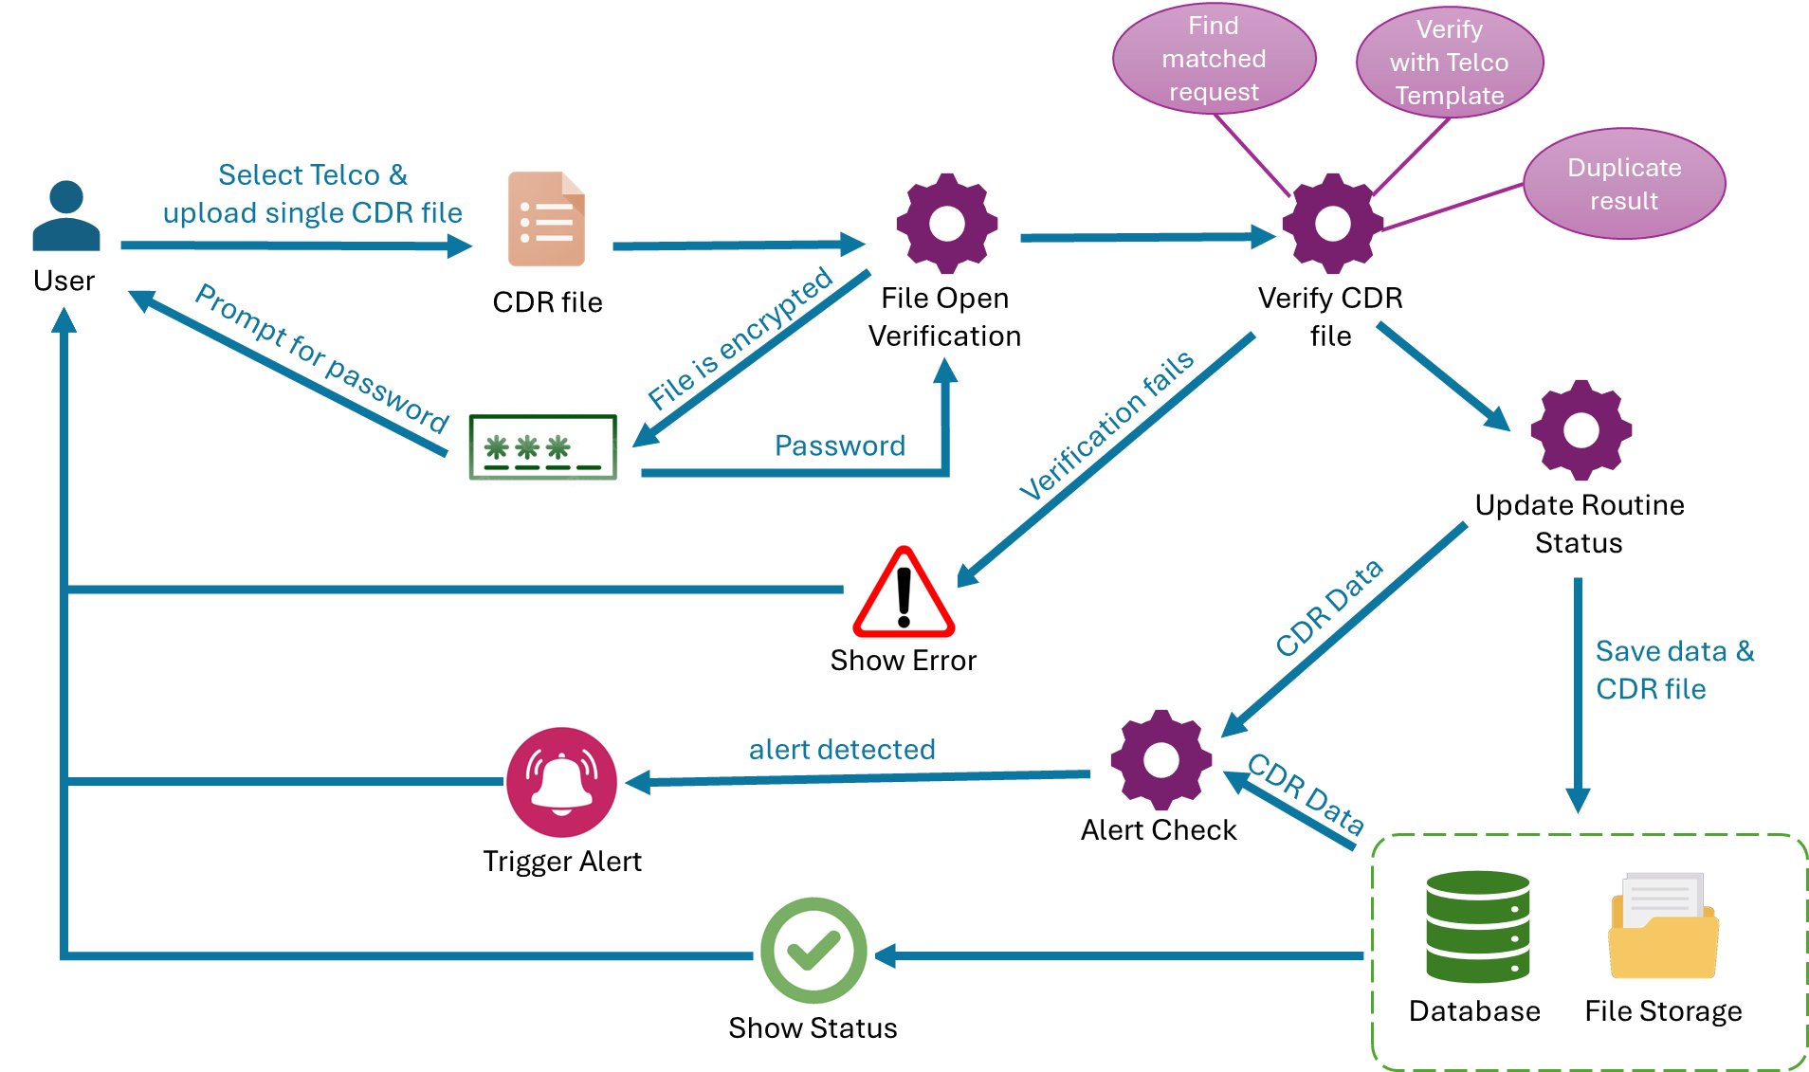
Import Data from Telco (Single Upload)

Slide 26
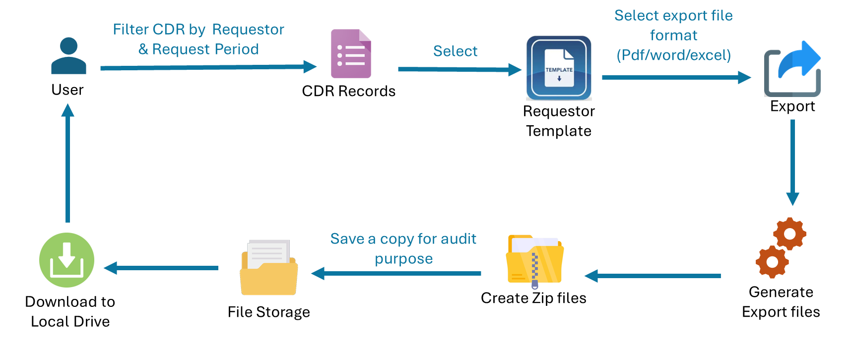
Request Delivery (CDR)
Files in zip folder will be organised as Requestor Dept/Telco/Project name
If TOI has no data from the requested period, a blank [TOI].txt file will be generated

Slide 27
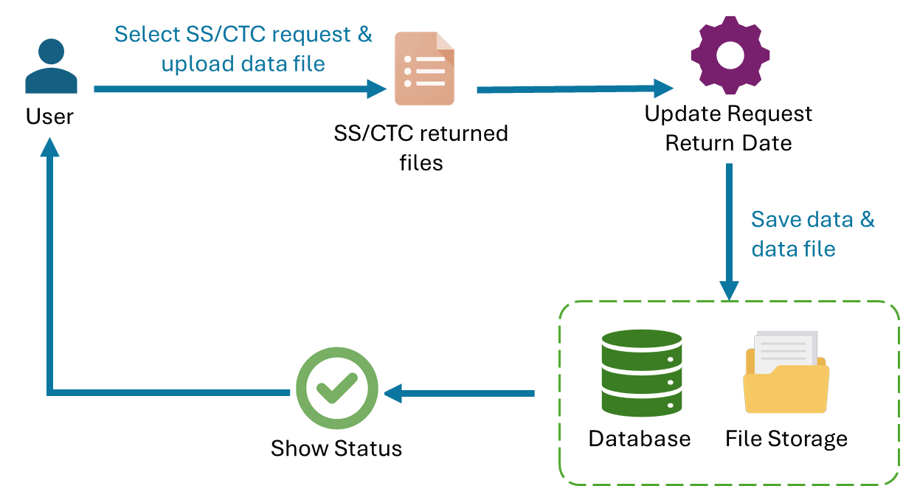
Import data files for SS/CTC requests
The purpose is to keep the raw file and no need to process the file

Slide 28
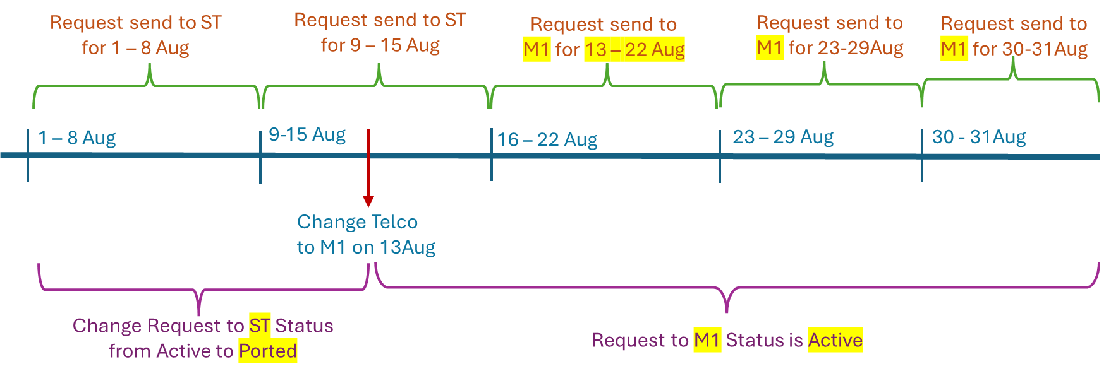
Change Service Provider
TOI: 91234567
Period: 1st Aug 25 to 31 Aug 25
Telco: ST
Status: Active
TOI: 91234567
Period: 1st Aug 25 to 12 Aug 25
Telco: ST
Status: Ported
TOI: 91234567
Period: 13 Aug 25 to 31 Aug 25
Telco: M1
Status: Active

Slide 29
Change Service Provider

Slide 30
Change Project Name
Two types of changes:
Change Project name to existing Project name
Change Project name to new Project name

Slide 31
Report Templates
Estimated 25 report templates (including ad-hoc, which not frequent)
Formulas includes:
pivot table, total, highest, lowest, median, avg, ratio etc - est 15 formula
We will re-visit the other report templates during workshop
Reports | Format
Shirt Return Report (Day/Night/Management/Urgent) | Excel
Monthly Report (Statistics/Telco) | Excel
Routine list (Weekends/weekday) | Excel
Ad hoc Statistics Report (Telco/Requestor/Project/Yearly/Monthly/Type…) | Word/PDF
Comparison Report with Graph/Charts representation | Word/PDF

Slide 32

Alerts
DBMS shall able to show alerts on the screen based on the rule-based conditions as shown in the Alert Templates below.
Types of alert:
Change IMEI;
Change IMSI;
Alert is configurable by the user
Alert notification:
Alert Icon shown at status bar;
View the alert trigger time and details;
Alert Templates
Field | Value
Alert Name | 91234567 change IMEI Alert
Entities | 91234567
Time Period – Start | 2nd Aug 2025
Time Period – End | 7th Aug 2025
Event | Change IMEI
Event: Change IMEI / Change IMSI

Slide 33
DBMS Features Overview

Slide 34
DBMS – Request Management

Slide 35
DBMS – Routine List Management
Preset Filters:
“InstantAction” - Filters requests that have not been generated into routine list before, and CDR Request Date End is at least one day earlier than today.
“RecurringAction” - Filters requests are generated into routine list before, and CDR Request Date End later than today.
“FreshAction” - Filters requests that have not been generated into routine list before, and CDR Request Date End later than today.

Slide 36
DBMS – CDR Data Management

Slide 37
DBMS - Reports
Customised Reports
Refer to the 25 report templates;
We will re-visit these report templates after CDR;

Slide 38
DBMS – Data Management

Slide 39
DBMS - Configuration
Template Editor
Allows user to configure the fields to be shown in the reports, routine list or exported CDR files to the requestors;
Telco CDR Import Template Editor
Allows user to configure fields to be imported to the database;
Configure mapping of Telco CDR fields to Standard CDR template (applies to new Telco CDR fields);

Slide 40
DBMS – Audit Logs

Slide 41
DBMS – Archived Data

Slide 42
DBMS - Alerts

Slide 43
Data Migration Tool
Data Migration from Access database to DBMS:
Challenges
No access to current Access database
Proposed Approach
User to provide the Access database schema;
User export data from Access to Excel file according to Access database schema;
EAS to provide a data migration tool:
Import the excel file;
Read the file and populate data to DBMS database;

Slide 44

Technical Design

Slide 45
CDR>RL>CDR Return>Alert>Approve
Autosave 10s
CDR Request Form
[Active][Draft]
ID
*TOI Fields Telco
Period
Normal/Urgent
Normal to Urgent
Status: New | In-Progress | Completed
[Cancel][Save][Save as Draft][Confirm Urgent & Generate]
Urgent Routine List
*TOI RequestID Period Status
Normal Routine List
*TOI RequestID Period Status
Routine List View
Filter *Request ID *TOI Period Status
[Confirm]
Generate
Urgent?
Normal to Urgent
Audit Logs
Date action userid details category
User’s Inbox
*Title Date Message Action
Update
CDR Return Zip File List
[New][List]
Prompt Password
Processing in background [Process] [Reupload]
Notification
Designer’s Inbox
*Title Date RequestID Action
Reports
Extra Fields
Status: Errors
Remarks
[Escalate]
Approval of Extra Field
Generate
Alert

Slide 46
CDR>RL>CDR Return>Alert>Approve
Autosave 10s
CDR Request Form
[Active][Draft]
ID
*TOI Fields Telco Active?
Period
Normal/Urgent
Normal to Urgent
Status: New | In-Progress | Partial | Completed
*Validation for Duplicate TOI
[Cancel][Save][Save as Draft][Confirm Urgent & Generate]
Urgent Routine List
*TOI RequestID Period Status
Normal Routine List
*TOI RequestID Period Status
Routine List View
Filter *Request ID *TOI Period Status
*Must take care of Orh Tang list
*Different Telco template
[Confirm]
Generate
Urgent?
Normal to Urgent
Audit Logs
Date action userid details category
Password Vault
Prefix – month - year
Update
CDR Return Zip File List
[New][List]
Prompt Password
Processing in background [Process] [Reupload]
Reports
Extra Fields
Status: Errors
Remarks
Edit Template
[RL Template][Base Tables]
Generate

Slide 47
Designer – Base Table List
Requestors
Telcos

Slide 48
Admin Portal
CRUD of users
CRUD of departments
CRUD of realm roles
Configuration of Password Policy
- 3 months mandatory change
Password characters
Archival Settings

Slide 49
Questions
Do we need timeout/lock screen for inactivity? No need

Slide 50
Thank you!

